Slide 1
Using Health Services

Slide 2
Important Terminology
Illness anxiety disorder (formerly: hypochondria/ hypochondriasis) – a mental health condition where a person interprets normal physical functions as indicators of a serious underlying illness; individuals with this illness can experience severe anxiety, fear, and distress
Medical students’ disease – a colloquialism for how many medical students report symptoms of the illness they are currently studying, leading them to believe they also have the illness
Acute illness – a short-term illness, often caused by a virus or bacteria; typically has no long-term consequences (ex: flu)
Chronic illness – a long-term illness, typically caused by a variety of factors, including health habits and genetics. This form of illness can have severe consequences (ex: heart disease)
Cyclic illness – an illness that goes through periods where symptoms are dormant or active (ex: herpes)
Lay referral network – an informal network of family and friends who provide their own interpretations of symptoms
Delay behavior – when a person experiencing notable symptoms avoids seeking healthcare
Ex: appraisal delay, illness delay, behavioral delay, and medical delay

Slide 3
Interpretations of Symptoms
To make the choice to access health care, a person needs to both pay attention to their physical experience and recognize symptoms as potential concerns
What makes people pay attention to their symptoms?
Personality differences (ex: individuals with higher anxiety/ neuroticism)
Self-awareness
Situational factors (distractions, life expectations, busy-ness, etc.)
Stress and mood
What contributes to if a person recognizes the symptoms as potential concerns?
Prior experience and knowledge about the illness
Expectations (expected symptoms are amplified, while unexpected symptoms are ignored)
Seriousness of the illness (impact to daily life function)

Slide 4
Commonsense Model of Illness
People hold implicit commonsense beliefs about their symptoms and illnesses
These beliefs results in schemas (representations) about illnesses. These schemas include information about:
Identity (name of the illness)
Causes
Consequences (symptoms, treatments, and implications for quality-of-life)
Timeline
Control/cure
Coherence (how well these beliefs all relate to the same disease)

Slide 5

Are factors like a lay referral network and the internet a “good” thing?

Slide 6
Who Uses Health Services?
Multiple factors impact if someone will utilize health services, including:
Age
Most likely to use: Very young and older adults
Gender
Most likely to use: Women (partially due to menstruation and childbirth)
Socioeconomic Status
Most likely to use: Individuals with higher SES and insurance
Regional impact of SES (affluent communities are more likely to have fully staffed health care services)
Culture/ social factors
Most likely to use: Individuals who grew up in a home who utilized health services; socially-connected individuals; individuals who trust the health care system

Slide 7
Misuse of Health Services
Two main categories of health service: overuse and disuse
Overusing health services:
Physicians estimate that 1/2 to 1/3 of their time is spent with psychological concerns rather than physical concerns
Psychosomatic symptoms (ex: anxiety causing heart racing and fatigue)
Lack of mental health education
Secondary gains
Ability to rest, support from others, time off work, free from unpleasant tasks

Slide 8
Misuse of Health Services
Disuse of health service:
People may not use health services due to factors such as financial concerns, lack of trust in health system, and lack of concern over symptoms
Delay behavior can occur at multiple stages:
Appraisal delay – time taken to decide that a symptom is serious
Illness delay – time between the recognition that a symptom implies an illness and the decision to seek treatment
Behavioral delay – time between deciding to seek treatment and doing so
Medical delay – time that elapses between the person’s calling for an appointment and his or her receiving appropriate medical care

Slide 9


When you hear hoofbeats…

Slide 10
Is It Real or Misuse of Health Services?
Fibromyalgia
A chronic illness characterized by widespread pain throughout the body
Underlying mechanism: nerve amplification and neural pathway alterations
Can impact health-related activities, such as sleep, exercise, and substance-use
Very difficult to diagnose
There’s no specific assessment; instead, other conditions are ruled out while tracking pain ratings
Patient may have to convince their health care providers that their illness is real
Factitious Disorder Imposed on Self/ Others
Previously called Munchausen syndrome
A psychological disorder characterized by a patient faking symptoms (or causing their own symptoms)
Individuals with FDIS often have a series of medical assessments that don’t match their reported symptoms
Additionally, they can have falsified documents/ altered tests
Very difficult to diagnose
There’s no specific assessment; instead, other conditions are ruled out while tracking health behaviors

Slide 11
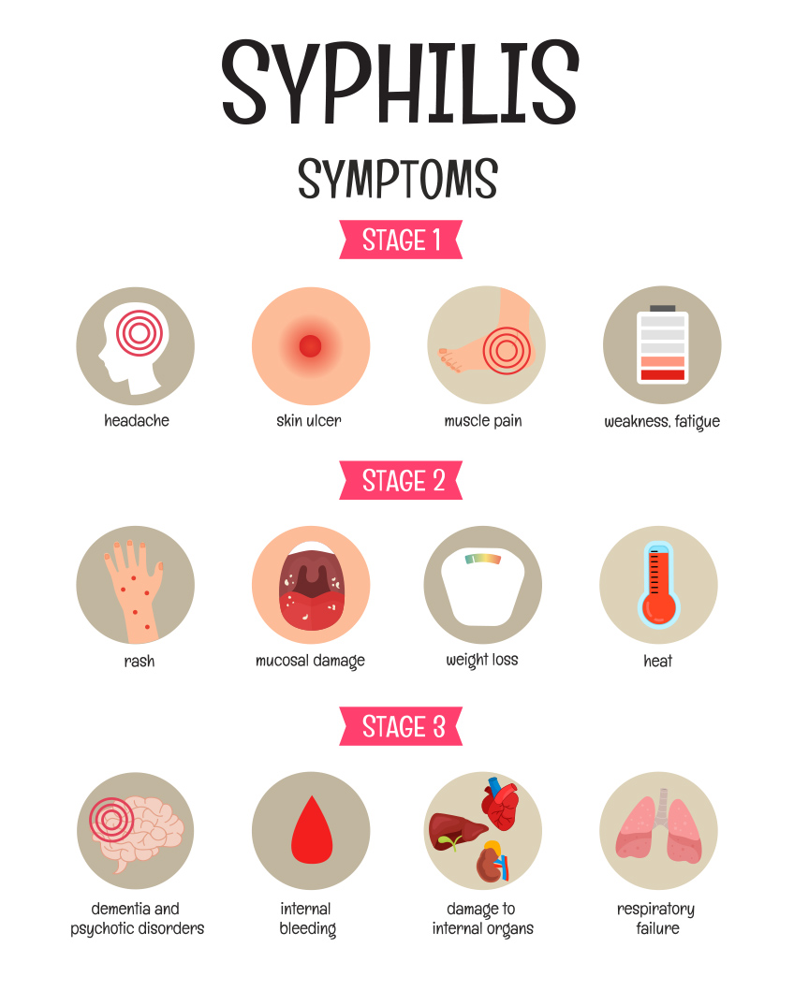

The Tuskegee Syphilis Experiment

